Slide 1

Design of Automated Shower For Physically Challenged Individuals
T. PraveenyA-20WH1A0477
B.AKShaya-20WH1A0479
V.LEENA-20WH1A0489
K.SNEHA BHUVANESHWARI-20WH1A04B5
Under the Guidance of
Dr. M. Parvathi, Professor
Department of Electronics and Communication Engineering
BVRIT HYDERABAD College Of Engineering For Women

Slide 2
Insights
Abstract
Literature Review
Operational Flow
Block Diagram
Tools Required
References
Output
Conclusion
Future Scope

Slide 3
Abstract
Problem Statement: Water conservation, utilization of accessible controls, enhancing safety, and adaptive technology to ensure user-friendly operation are the major issues identified in the existing shower systems specifically meant for physically challenged people.
Existing Solution: The existing shower systems rely on manual adjustments making it challenging to set the desired water temperature and flow rate[1] when it is used for disabled individuals. While some systems use thermostatic valves for consistent temperature, they still necessitate initial manual setup, causing inconvenience [2].
Proposed Method: Proposed an innovative shower system for physically challenged individuals that integrates cutting-edge technologies like voice recognition. It offers adjustable settings for water, pressure and shower head positioning, prioritizes safety & emergency shut-off options. It is suitable for people with Alzheimer’s, aged or lazy people, autistic people and can be used partially for blind people.

Slide 4
Literature Review
Title | Author | Year of Publication | Invention | Limitation
Flow Controllable Shower Arm | M. Sirkin | 2010 | Control the flow of water | There is no sitting option for disable people.
Disability Shower | William R. Shrewsbury | 2012 | Shower unit have shower seat which is used for disable people | No control of water while soaping
Design of an Autonomous Smart Shower with Sensors and Actuators | Tareq Khan | 2018 | Controlling the flow of water when soaping and to reduce water usage | Manual temperature adjustment
Design Of Automatic Sensor Equipped Shower | Mahmod Abd Hakim Mohamad, Yahaya Ramli et.al | 2022 | Controlling temperature by Bluetooth technology via mobile | No Automatic controlling like hand gestures and voice

Slide 5
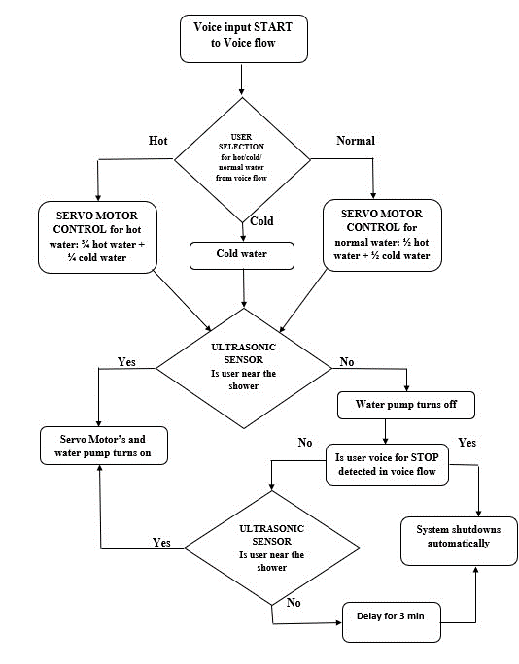
Operational Flow

Slide 6
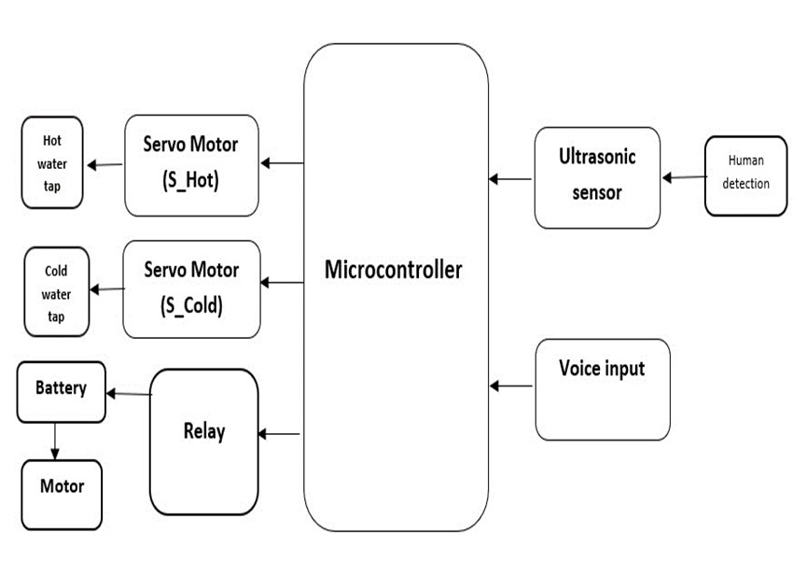
Block Diagram

Slide 7
Tools Required
HARDWARE
ESP-WROOM-32
Servo motors
Ultrasonic Sensor
Relay
DC Motor Water Pump
Battery
SOFTWARE
Arduino IDE
Voice Flow
Blynk Console

Slide 8
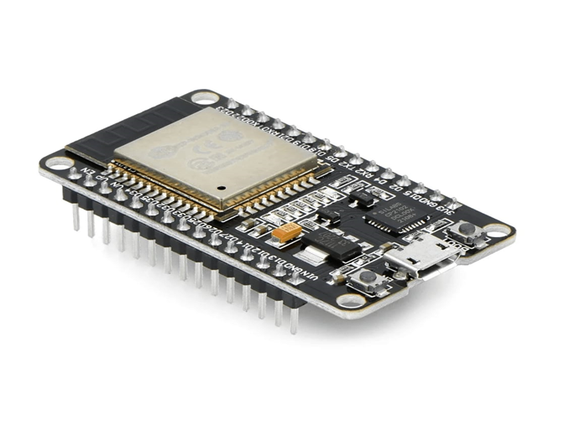
Microcontroller:
We use ESP-WROOM-32 for all the I/O connections.
Here the control unit is Arduino IDE software to program the sensor

Slide 9
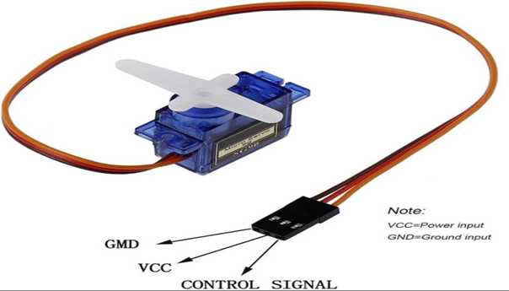
Servo Motors
Servo motors allow to precisely control the rotation angle of the taps.
These are used to control and rotate the valve handles of hot and cold water supplies.
Usage of Servo Motors:
Hot Water:- ¾ Hot + ¼ Cold
Normal Water:- ½ Hot + ½ Cold
Cold Water:- 0 Hot + 1 Cold

Slide 10
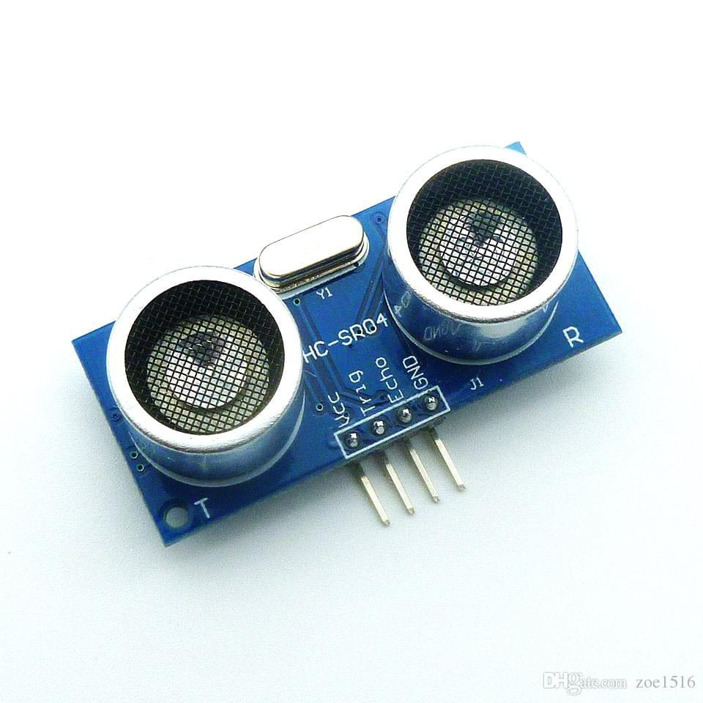
Ultrasonic Sensor
The ultrasonic distance sensor is used to measure the proximity of the user under the shower.
This economical sensor provides 2cm to 400cm of non contact measurement functionality.
It also includes an ultrasonic transmitter, a receiver and a control circuit

Slide 11
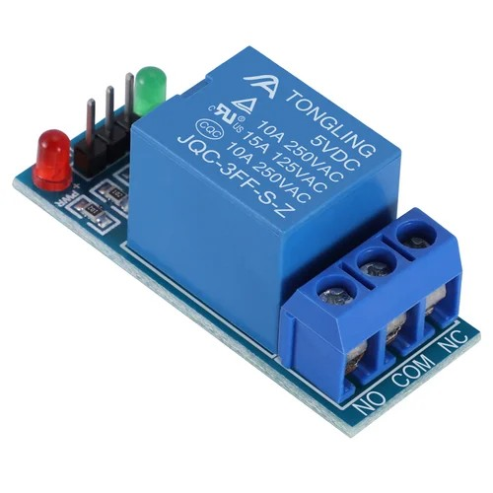
RELAY
Relay is an electro-mechanical device which acts as a switch.
In our automated shower system, relays serve as essential components for controlling the water pump based on user presence detection.
These electromechanical switches are strategically integrated within the system to manage the flow of electricity to the water pump.

Slide 12
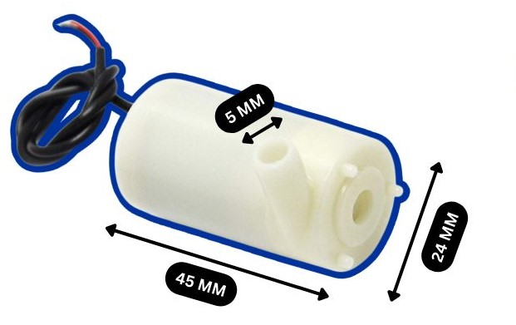
DC MOTOR WATER PUMP
This versatile pump seamlessly integrates with the system's user detection mechanism, ensuring that water flow commences only when a user is present within the shower stall.
Upon receiving signals from the ultrasonic sensors indicating the presence of a user, the system's microcontroller activates the 12V DC motor pump.

Slide 13
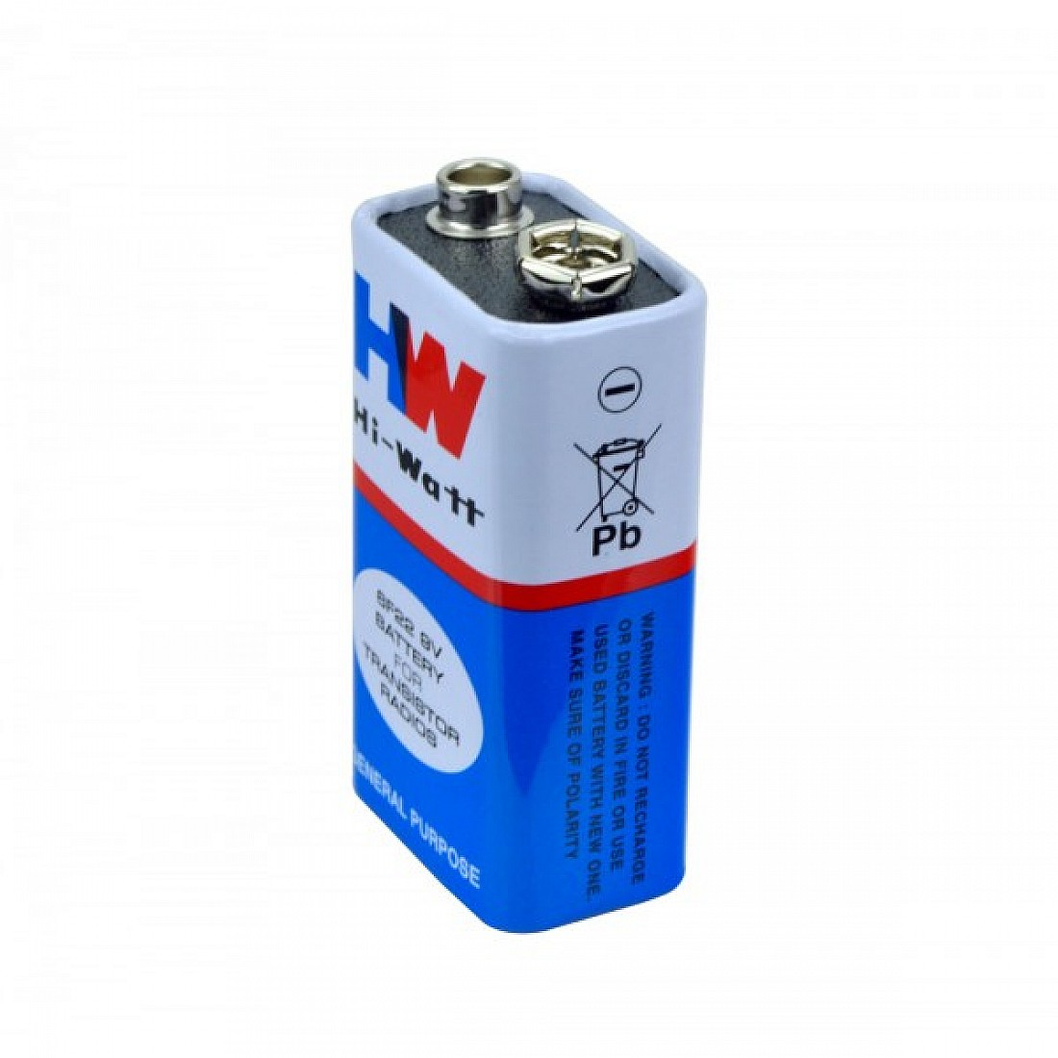
Battery
Our automated shower system harnesses the power of a battery to energize the DC motor pump, ensuring a continuous and reliable flow of water.
The battery, strategically positioned within the system's enclosure, serves as the primary source of electricity, providing the necessary energy to activate and maintain the pump's operation.

Slide 14

ARDUINO IDE
This open-source software enables developers to create customized code that governs the operation of the ultrasonic sensors, servo motors, and dc motor pump, ensuring precise control over water flow, temperature adjustment, and user detection.

Slide 15
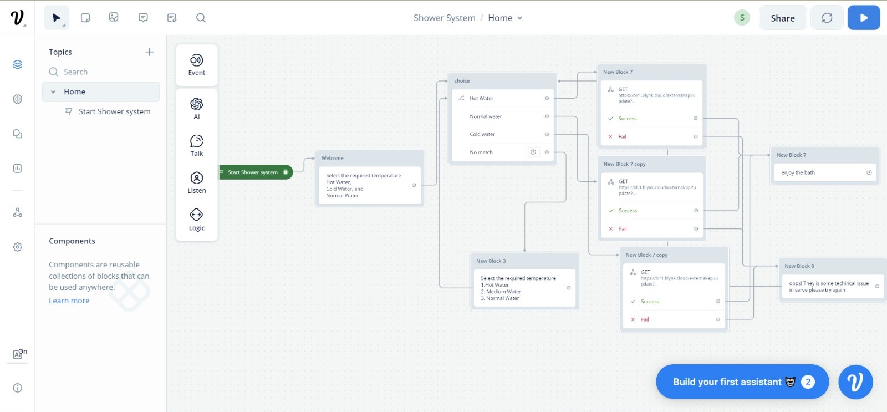
VOICE FLOW
The voice flow platform enables hands-free control through voice recognition.
By translating voice commands into text and relaying them to the blynk app, voice flow empowers users to manage the system effortlessly.

Slide 16
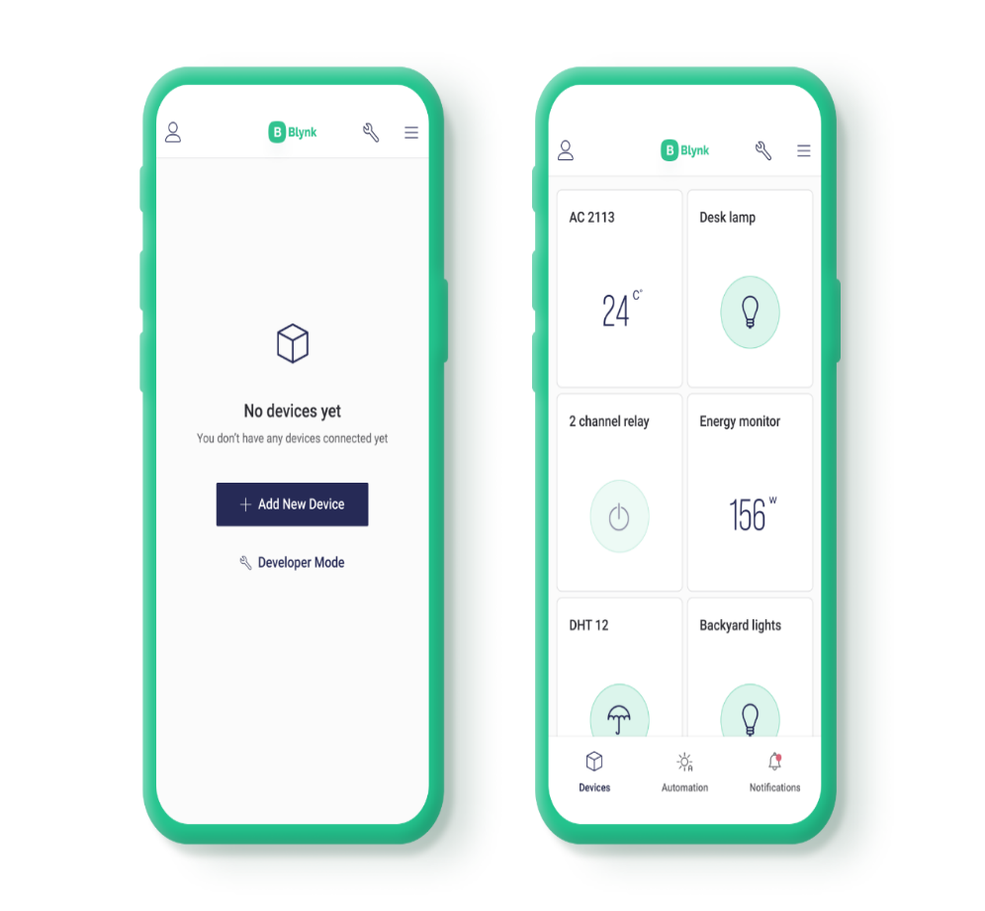
Blynk CONSOLE
The blynk platform in our automated shower system offers remote monitoring and control of the system's components.
Through the blynk mobile app, users can visualize sensor data and control actuators, enhancing their showering experience and promoting independence.

Slide 17
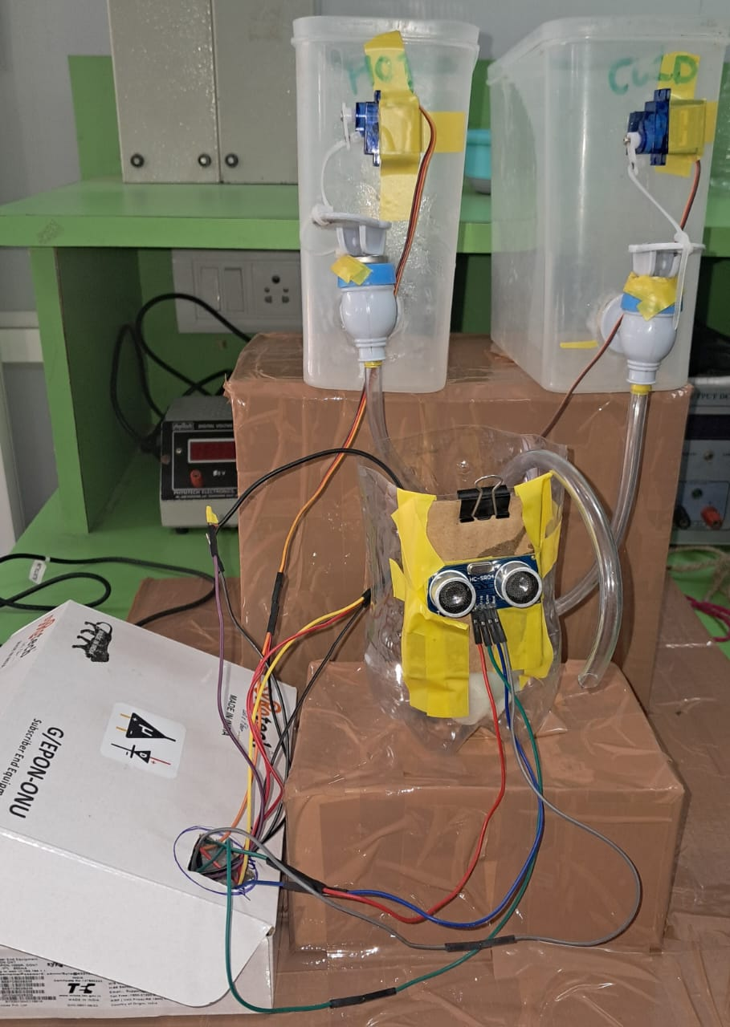
OUTPUT

Slide 18
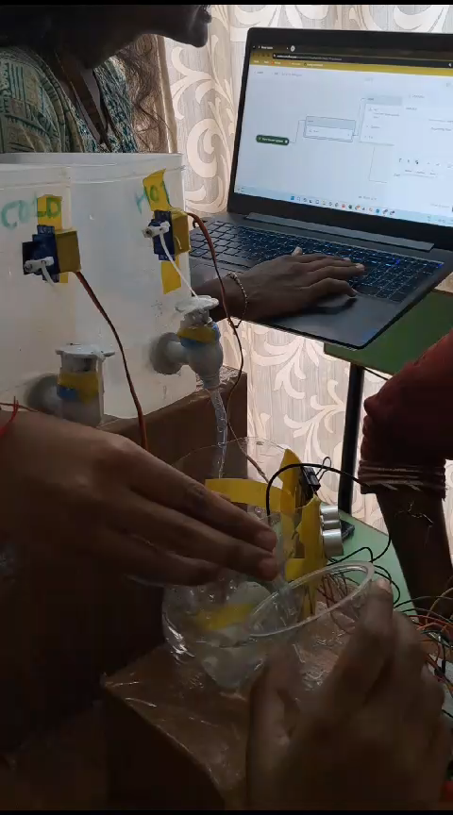

Slide 19
CONCLUSION
Our proposed shower system is not just a technological upgrade but a step towards inclusivity and enhanced daily living. By seamlessly integrating voice recognition, we've aimed to redefine the shower experience for physically challenged individuals.
The adjustable settings cater to diverse needs, while safety features, including emergency shut-off, prioritize user well-being.
This innovative system goes beyond its primary audience, offering practical benefits for individuals with Alzheimer's, the elderly, those with autism, and even partial usability for the visually impaired. It's not just a shower; it's a user-centric solution designed to make a positive impact on the daily lives of various user groups.

Slide 20
FUTURE SCOPE
By incorporating gesture recognition technology, users could interact with the shower system using simple hand movements, adding an additional layer of accessibility. This could be particularly beneficial for individuals who may find voice commands challenging.
Enhancing the system's capability to provide exact temperatures is crucial for a more personalized and comfortable shower experience. Implementing advanced temperature sensors and precision control mechanisms can enable users to specify and achieve their desired water temperature with greater accuracy.
Combining hand gestures with precise temperature control could create a seamless and intuitive interaction model. Users could use gestures to adjust water temperature and flow in real-time, providing a responsive and customizable experience.

Slide 21
References
Khan, Tareq. (2018). Design of an Autonomous Smart Shower with Sensors and Actuators. 8. 01-17. 10.5121/ijesa.2018.8301.
Mahmod Abd Hakim Mohamad1, Yahaya Ramli2, Mohamad Faris Aiqal Mohamad Fadzli Amin3, Mohammad Shahrolnizam Ismail3, Muhammad Faizal Ismail4. (28 July 2022) Design of Automatic Sensor Equipped Shower from http://publisher.uthm.edu.my/periodicals/index.php/mari e-ISSN :2773-4773
Zhao, Qiliang et al. “Automatic Control of Shower Equipment for Elderly People or People with Physical Disabilities.” (2013).
W. Wang, Y. Chen, X. Zou, S. Wang, J. P. Ferreira and T. Liu, & quot; Development of Bath Auxiliary Robot for the Disabled Elderly & quot; 2021 IEEE International Conference on Intelligence and Safety for Robotics (ISR), Tokoname, Japan, 2021, pp. 85-88, doi:10.1109/ISR50024.2021.9419499.

Slide 22
THANK YOU

